Slide 1



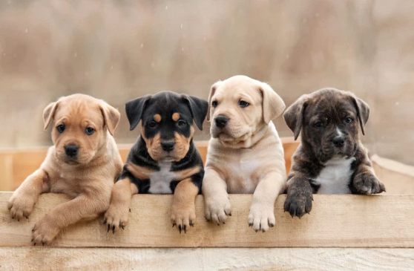
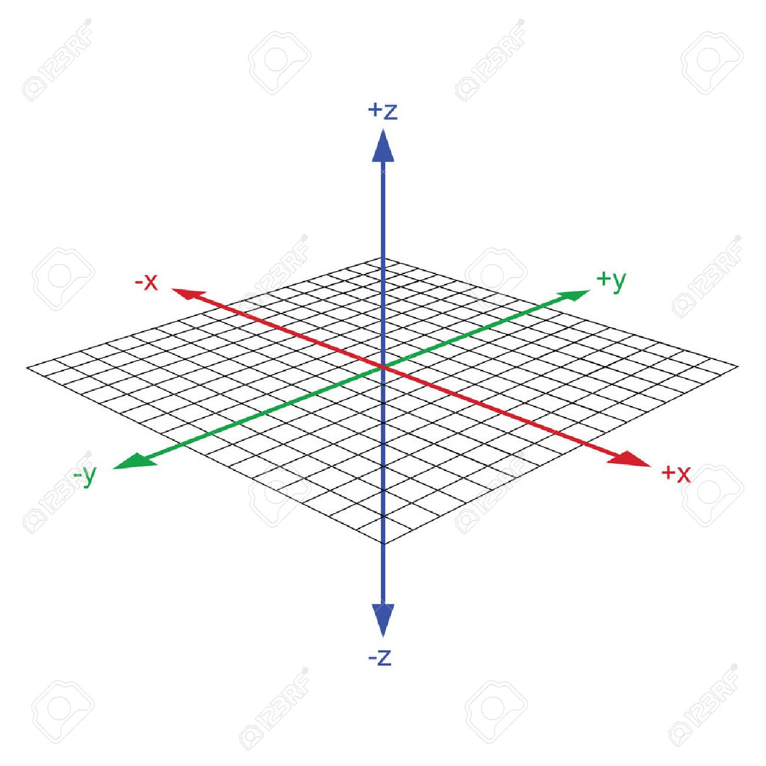
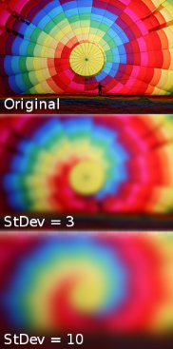
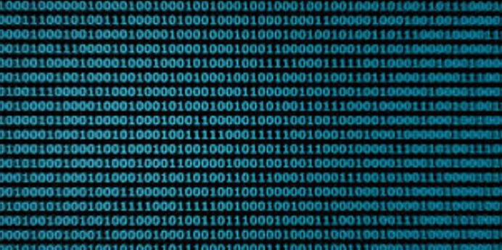




M
A
I
N
D
E
V
I
C
E
Color conversion
[영상처리 라이브러리]
Get Image
Removal
Background
conversion Image
Find Dog Object
Check Object Coordinate
Image Blurring
[영상처리 라이브러리]
Don’t Find
Dog Object
Change the
Image Coordinate
Camera Tile
Receive the Coordinate
Change The
Tile Machine
Focus On
Dog Image

Slide 2

M
A
I
N
D
E
V
I
C
E
Don’t Find
Dog Object
Removal
Background
Get Image
Image blocking
[Pixy2 라이브러리]
conversion Image
Color conversion
[영상처리 라이브러리]
Find Dog Object
Check Object Coordinate
Camera Tile
Change the
Image Coordinate
Receive the Coordinate
Focus On
Dog Image
Change The
Tile Machine

Slide 3



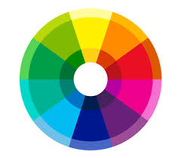



S
U
B
D
E
V
I
C
E
Color conversion
[영상처리 라이브러리]
Get Image
Identify
Day
conversion Image
Set Range Image
conversion Image
Image Blurring
[영상처리 라이브러리]
Discordance Day
Data Reset
Pixel Color
Comparison
Color comparison matching
Examination overlap
Decision Dog
Bowel Movement
Frame
Division
None Overlap
Overlap Data

